Slide 1
WELCOME TO THE DEFENSE OF SOFTWARE ENGINEERING CITEC-HITM
PLEASE, TURN OFF YOUR CELL PHONE’S SOUND!!!

Slide 2


THE UNIVERSITY OF BAMENDA Uba L’UNIVERSITE DE BAMENDA
CITEC HIGHER INSTITUTE OF TECHNOLOGY AND MANAGEMENT (CITEC-HITM)
INSTITUT SUPERIEUR DE TECHNOLOGIE ET DE GESTION
DEPARTMENT OF COMPUTER
ENGINEERING
DEPARTEMENT DE GENIE
INFORMATIQUE
A Project Submitted in partial Fulfilment of the Requirements for the Award of a Professional Bachelor’s Degree, in Software Engineering.
PERFORMANCE EVALUATION AND COMPARISON OF PROCESS SCHEDULING ALGORITHM IN OPERATING SYSTEMS, case of CAM-TRAV INTERNATIONAL CONSULTING-DOUALA, CAMEROON.
Presented By:
ABANJI DIEUDONNE
Supervised By:
Mr. FONILECK KINGSLEY CHE

Slide 3
INTRODUCTION.
PROBLEM STATEMENT.
PROPOSED SOLUTION.
MATERIAL USED.
METHODOLOGY.
RESULTS.
RECOMMENDATIONS.
FUTURE WORKS
CONCLUSION.
PLAN

Slide 4
INTRODUCTION
Our utmost focus is on Process Scheduling in Operating Systems.
The fundamental function is to be able identify which algorithm best works with a given task or process.
CONTEXT

Slide 5
Evaluate the performance of different Process Scheduling Algorithms under a variety of workloads
Compare the performances of the FCFS, RR, SJF, PBS, in terms of their ability to minimize response time, maximize throughput and provide fair allocation of system resources.
Seek to measure the quality of service, such as fairness, starvation avoidance, and predictability.
OBJECTIVES

Slide 6
PROBLEM STATEMENT
The problem that this thesis will address is the need for a fair and efficient process scheduling algorithm for operating systems.
As a result, what the computer prioritizes is not what is a priority to the user.
Current scheduling algorithms have different strengths and weaknesses, and there is no single algorithm that is best for all situations. This thesis will evaluate and compare the performance of different scheduling algorithms in order to identify the best algorithm for a specific application.

Slide 7
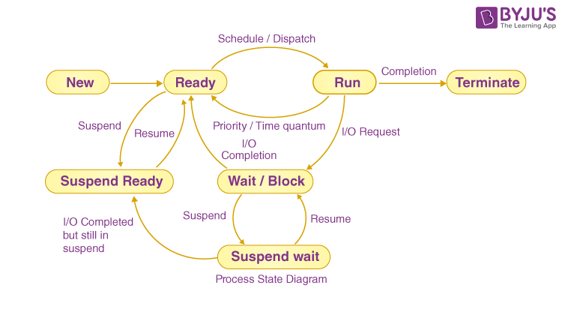
PROCESS EXECUTION CYCLE

Slide 8
PROPOSED SOLUTION
Identify what kind of task a user will be carrying out, while designing an operating system for their computer.
Consider the Users’ Priority and not the Computer’s.
Use the Permission Scheduling Algorithm.

Slide 9
MATERIAL USED
A Dell Laptop, with 32GB of RAM, 512 GB of SSD, with a 2.30 GHz Processor speed.
Installed in it, was Windows 11 Professional Operating System.

Slide 10
METHODOLOGY
Visual Representation of an Occurrence.
Shows Processes and their Progress.
Easy to Analysis, and Interpret.
Henry Laurence Gantt’s Chart:

Slide 11
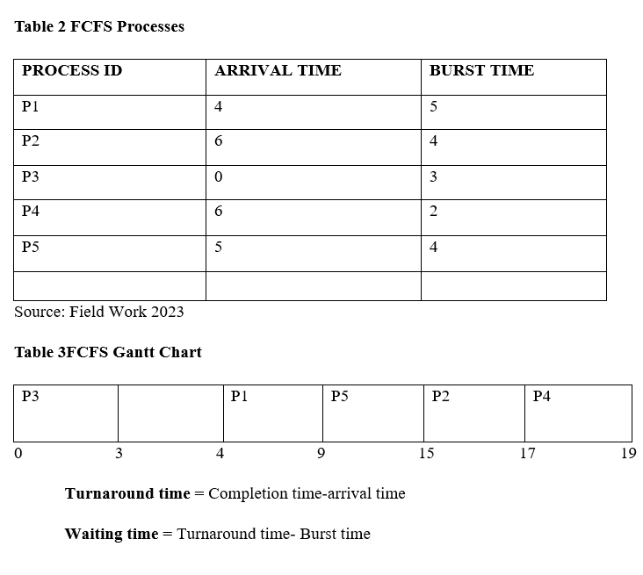
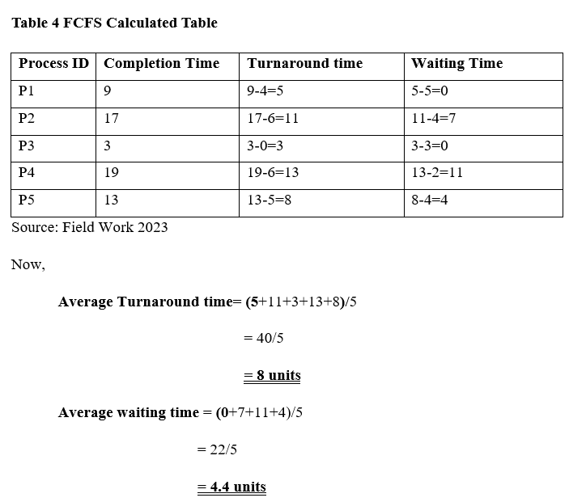
RESULTS

Slide 12
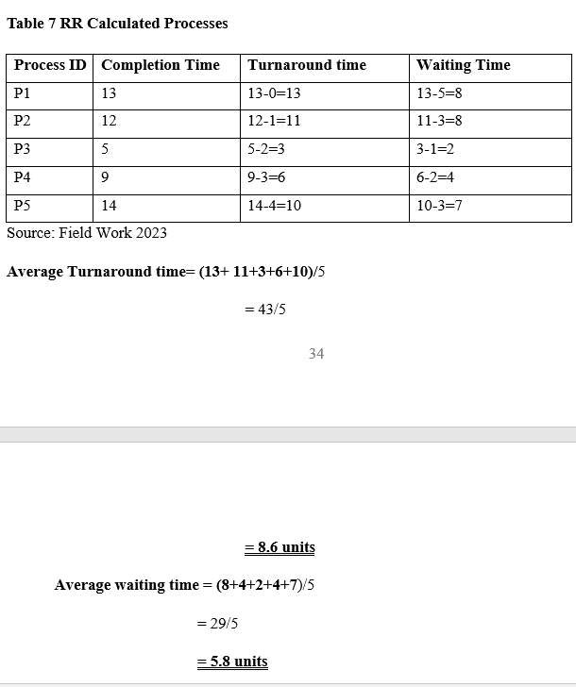
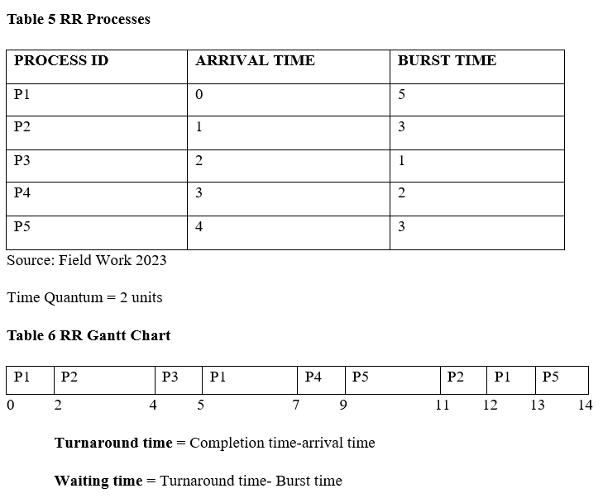
ROUND ROBINS SCHEDULING

Slide 13
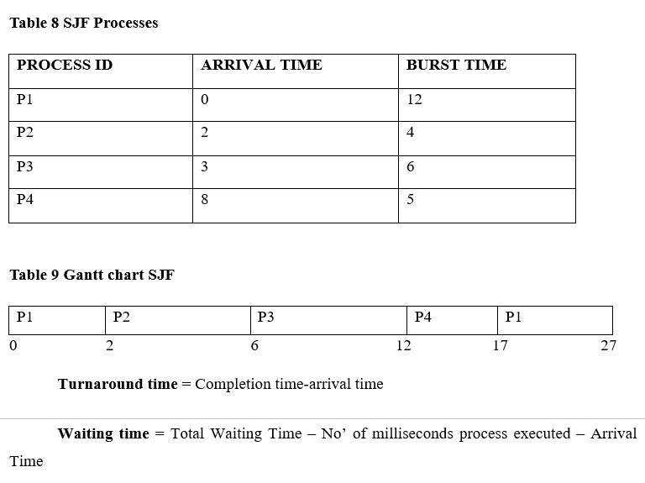
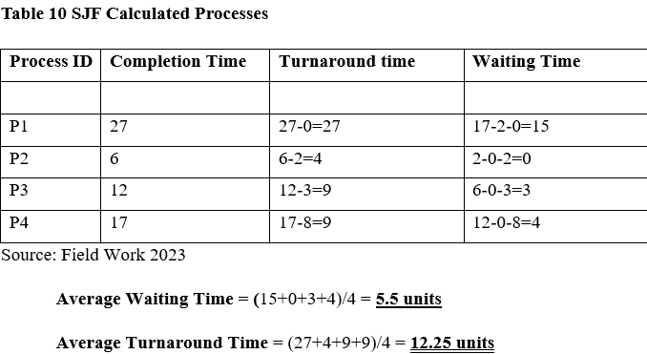
SHORTEST JOB FIRST SCHEDULING

Slide 14
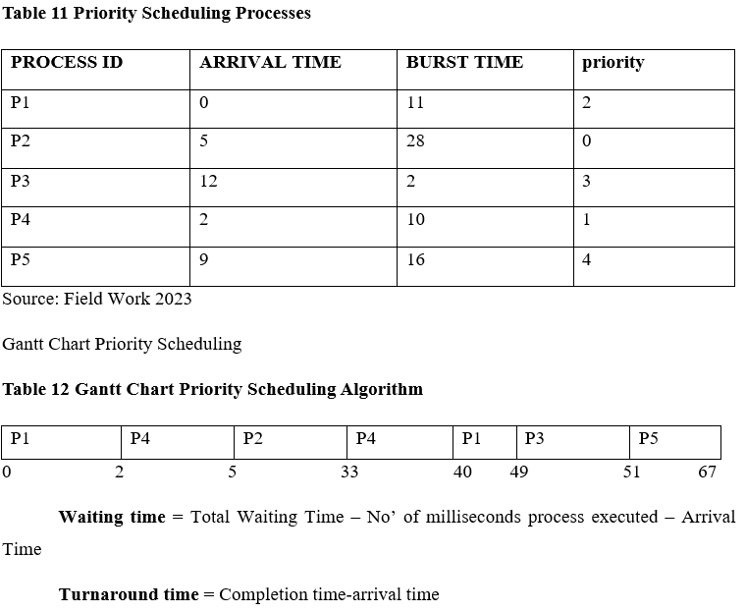
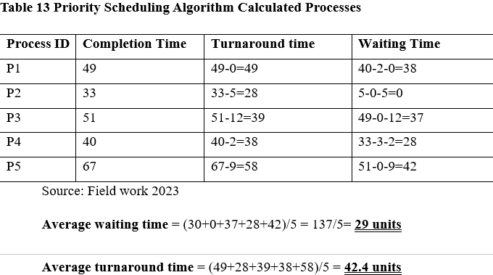
Priority Based Scheduling.

Slide 15
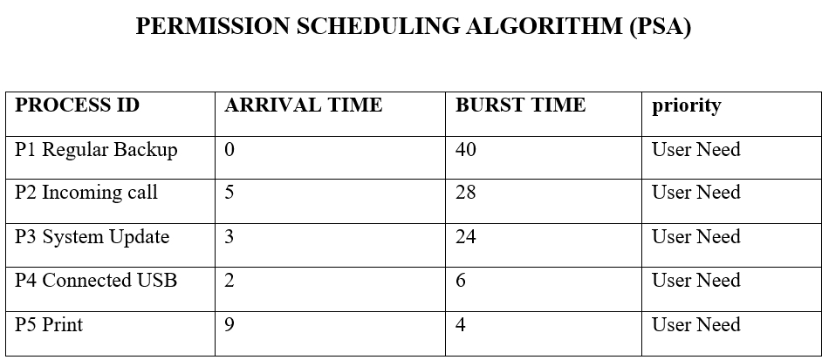
RECOMMNEDATIONS
Switch from traditional Process algorithm, by implementing a user-centric algorithm.

Slide 16
Future Works
This piece of work is open for further research , modifications, and updating.

Slide 17
CONCLUSION
There is no best algorithm , but there are better algorithms for different purposes.
In order to make an efficient use of the system resources, it is imperative to know what task works best with a chosen algorithm.
When users have a full control of how system resources should be use, they tend to get the best of the system.

Slide 18
THANK YOU
FOR
LISTENING.

